Slide 1
11-3 Moisture in the Atmosphere

Slide 2
Cloud formation
Air generally contains the same amount of water vapor
Warm air rising and cool air sinking
Tendency to rise or sink is called what?
Buoyancy
Small particles in the atmosphere from which cloud droplets can formed are called what?
Condensation Nuclei

Slide 3
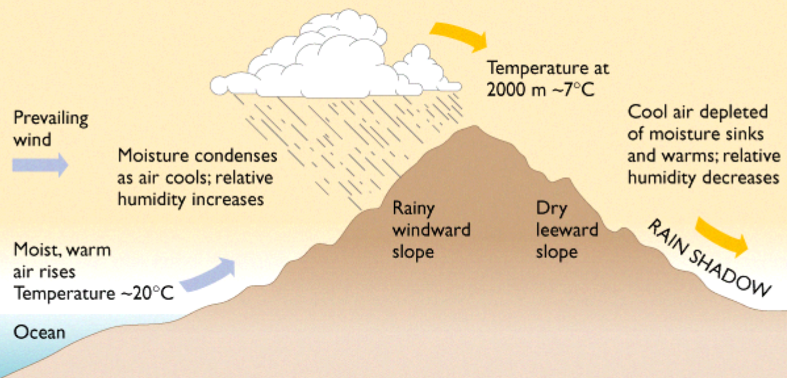
Cloud formation
Orographic lifting
Cloud formation over a _______________
Air rises and cools

Slide 4
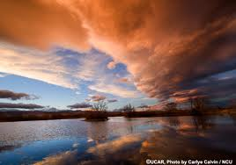
Cloud Stability
Ability of an air mass to resist rising
Unstable if air is cooler than surface beneath it
Heat flows from the warmer surface to the cooler air
Less dense air mass rises- if enough: produces thunderclouds

Slide 5
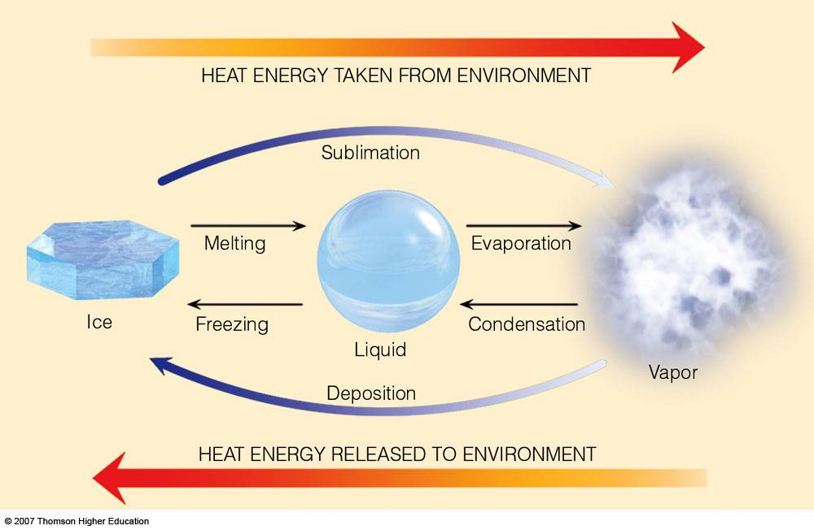
Latent Heat
As water vapor condenses, ____________ is released
The energy needed to change liquid to gas is stored and not released until condensation occurs
Latent Heat
Provides energy to a weather system increasing intensity

Slide 6
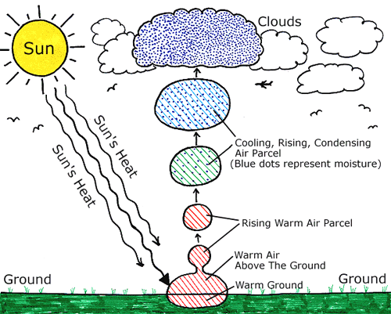
Cloud Formation
Formed when rising air reaches LCL
Water vapor condenses into droplets of liquid water or ice
Takes place at different altitudes
Fog: at earth’s surface

Slide 7
Chart
Fill out the cloud type chart
Height | Shape
Cirro: | Cirrus:
Alto: | Cumulus:
Strato: | Stratus:
 | Nimbus:

Slide 8
Height | Shape
Cirro: 6000m+ | Cirrus: “hair” - whispy
Alto: 2000m-6000m | Cumulus: “pile”-puffy, lumpy
Strato: -2000m | Stratus: “layer”- sheets
 | Nimbus: “cloud”- low, grey

Slide 9
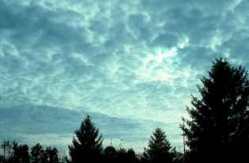
Clouds
Low Clouds
Water droplets
If air stays cold, wind will spread it horizontally
Stratocumulus
Covers much of the sky at a given area

Slide 10
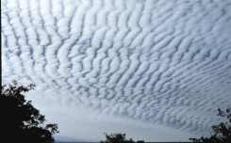
Clouds
Middle Clouds
Because of cooler temps, may be formed from liquid water or ice crystals
Altocumulus, altostratus
Mild precipitation

Slide 11
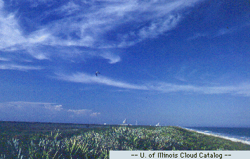
Clouds
High Clouds
Because of high altitude, clouds are from ice crystals
Wispy and distinct appearance
Varies in thickness

Slide 12
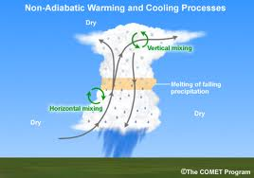
Clouds: Vertical Development
If unstable, cumulus cloud will be warmer that air
Will grow & rise while condensing water vapor warms air around it: Latent Heat
May reach up to 18,000 meters
Top forms ice crystals, wind spreads to an “Anvil” shape
Thunderstorms

Slide 13
Precipitation
When droplets collide, join together to form larger droplets
Coalescence
Gravity takes over and when heavy enough, droplet falls as precipitation
Snow, rain, sleet, hail
Water Cylce
Precipitation → Runoff → Evaporation → Condensation

